Slide 1
Section 5.1
Definition and Evaluating Absolute Values

Slide 2

What is an Absolute Value?
The Absolute value notation is defined as the distance of any value from zero
Distance is always positive, so the Absolute value of a positive number stays positive and the ABS of a negative number becomes positive
Evaluate the following:

Slide 3
Practice: Evaluate the following ABS Expressions:

Slide 4
Definitions of an absolute Value:
There are two ways to define what an absolute value is in senior math courses:
PIECE-WISE FUNCTION:
If “x” is greater than zero (positive), then the abs of “x” will just be “x” (stays positive)
If “x” is less than zero (negative), then the abs of “x” will be “x” times negative one. A negative value multiplied negative one stays positive
Square Root of a Square
Despite whether if “x” is negative or positive, when we square it, it will always be a positive value. Then we square root it, making it positive
NOTE: When we square root a positive value, we should get only ONE answer!!
The plus or minus is only there if we are solving equations:

Slide 5
Practice:
Which is bigger?
Which is smaller?
Example 2: Order the numbers from least to Greatest.

Slide 6
Example 2: Order the numbers from least to Greatest.

Slide 7
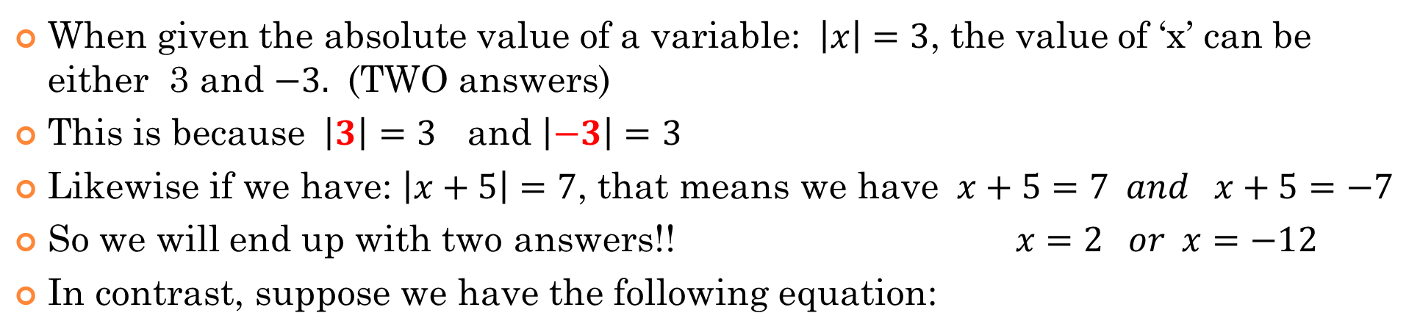
Absolute Values as a Function:
When given the absolute value of a variable: $\left|x\right|=3$, the value of ‘x’ can be either 3 and $−3.$ (TWO answers)
This is because $\left|3\right|=3$ and $\left|−3\right|=3$
Likewise if we have: $\left|x+5\right|=7$, that means we have $x+5=7 and x+5=−7$
So we will end up with two answers!! $x=2 or x=−12$
In contrast, suppose we have the following equation:
This equation will have no answers because the absolute value can not be negative
This equation will have TWO answers because the equations inside the radical can be 20 or -20

Slide 8
If $\left|x+3\right|=12$, what are the possible value(s) of “x”?
a) x = 9
b) x = – 9
c) x = 15
d) x = – 15
e) x = –15 or x = 9
f) x = –9 or x = 15

Slide 9

Which of the following equations will have no solutions?
a) $\left|x−5\right|=20$
b) $\left|x+4\right|=−7$
c) $−2\left|x+3\right|=−10$
d) $−\left|x−7\right|=13$
e) $\left|x−5\right|=\left|−20\right|$
f) $−\left|x\right|=5$

Slide 10
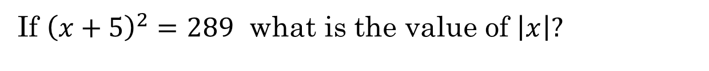
If ${\left(x+5\right)}^{2}=289$ what is the value of $\left|x\right|?$
a) x = 12
b) x = – 12
c) x = 22
d) x = – 22
e) x = –22 or x = 12
f) x = –12 or x = 22
g) x = 12 or x = 22

Slide 11


WHY $x^{2}=k$ gives two SOLUTIONS!
When we are solving an equation in the form of the expressions below
We would take the square root of both sides of the equation
Using the definition of an ABS value, the left side is actually the absolute value of “x”. Whereas, the right side is only the positive root
The value inside the ABS value can be negative, so we get TWO answers!!!
NOTE: $\sqrt{25}=5$ only!!! NOT $−5$
ie: $\sqrt{16}=4$ only!!! NOT $−4$

Slide 12
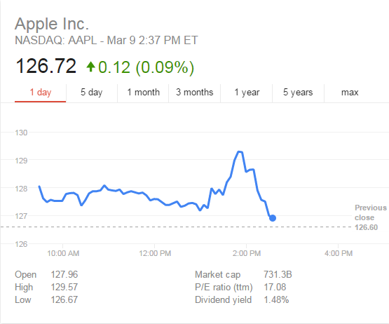

On March 9, 2015, the Apple watch was unveiled. The stock price went from $128 to 127.20 right before the keynote. Then it rose to $129.30 during the keynote. Afterwards, it fell to $127.
Determine the total change of this stock for the day:

